Slide 1
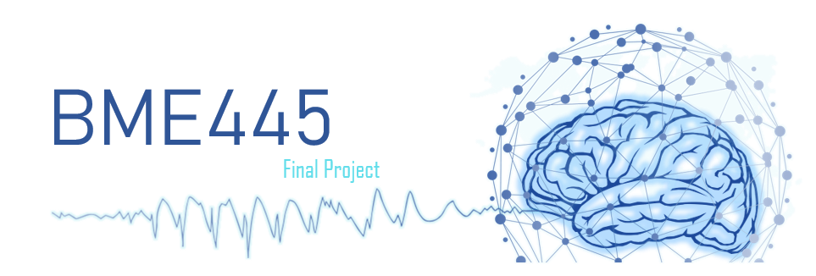
Sebastian Wardzinski - 1004070676
Curtis Ming-Fung Lai - 1003355870
Luis Camero - 1003325822
Marcos David Madrigal Albores - 1004731347

Slide 2
Agenda
Context: Core Conductor Model
Spatiotemporal Profiles
Transmembrane voltage
Transmembrane current
Lumped monopoles
Extracellular potentials
Summary
Closing Thoughts

Slide 3
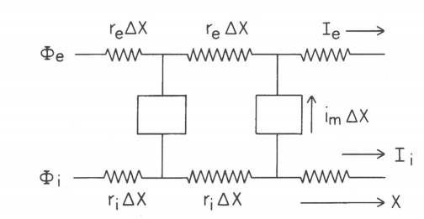
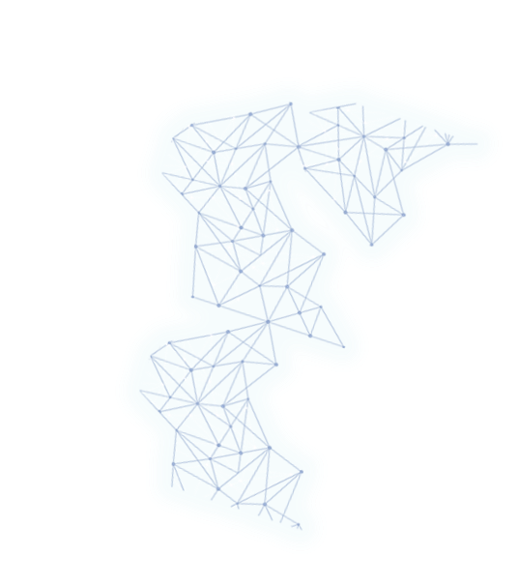
The Core Conductor Model for a Cylindrical Cell
Brief Description
Approximate cell as a uniform cylinder
Membrane is dissected into small segments connected by each other
each segment contains resistance and capacitance
Notes:
We uses a cylindrical cell as the core conductor model to approximate an axon of parts of dendrite. The membrane is dissected into small segments that is interconnected by one and other. Each segment contains resistance and capacitance. (next slide)

Slide 4
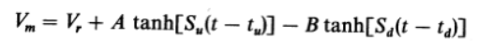
Environment and Model Characteristics
Assumptions
Fiber radius << cable length
Current & potentials only changes horizontally
Large extracellular space, therefore infinite extracellular conductance
The Voltage Function
Notes:
We made 3 assumptions for the core conductor model. First, we assume the fiber radius is much smaller than the cable length. Therefore, current and potentials propagated only horizontally. Also, we assume there is a large extracellular space outside of the membrane, therefore there is infinite extracellular conductance.
Below is the Voltage Function. The first term represent the constant resting potential. The second positive tanh term represents the initial spike of the potential. The final negative tanh term represent the eventual drop of the voltage across the membrane. (next slide)

Slide 5
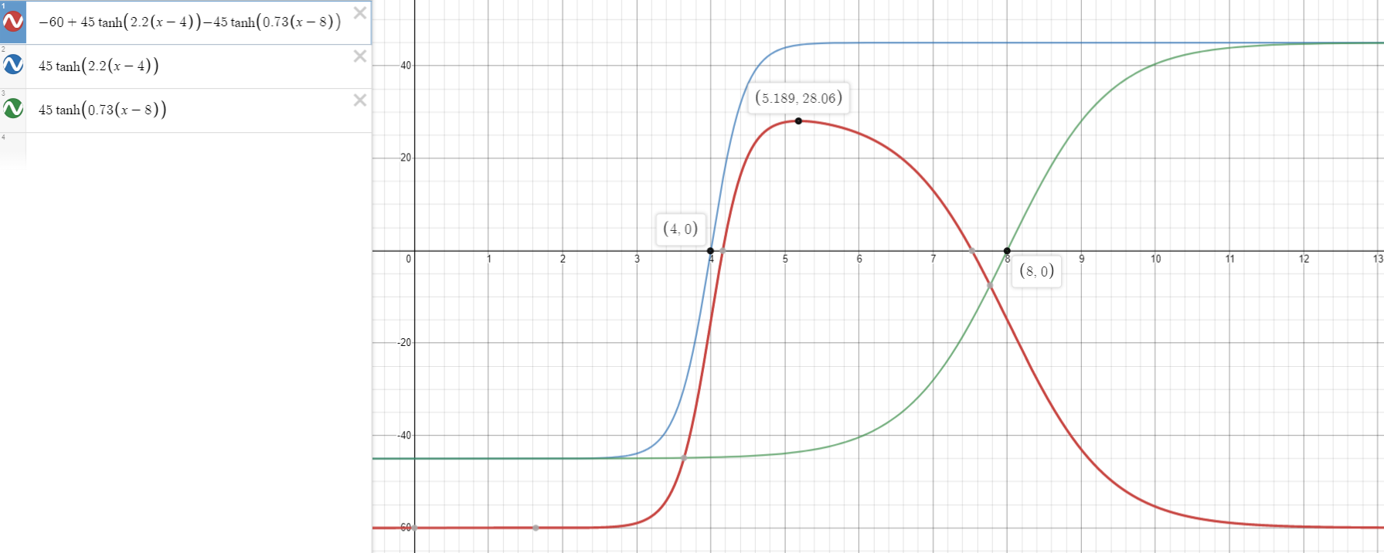
The Transmembrane Voltage
Characteristics
resting voltage: -60 mV
peak voltage: 30 mV
upstroke center: 4 ms
downstroke center: 8 ms
rising time: 1 ms
falling time: 3 ms
speed of propagation: 2 m/s
Equation:
Notes:
Here is some context form the appended problems
The simulation had a resting voltage of -60mV. You can see the time constant for the positive tanh term is larger than the negative tanh term. It also has a much smaller delay than the latter term. As a result, depolarization is much faster and earlier than the repolarization. There is no hyperpolarization and the speed of propagation is approximately 2 meters per second. (next slide)

Slide 6
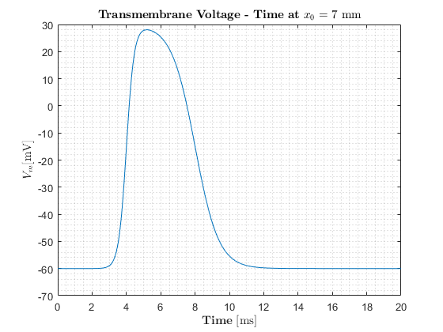
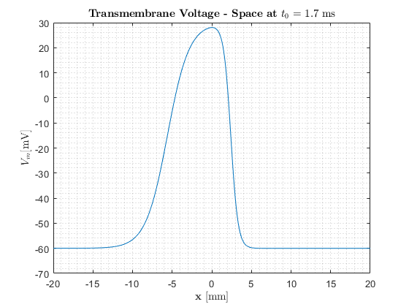
Transmembrane Voltage
Temporal Profile Space Profile
Notes:
Below is the temporal and space plot of the transmembrane voltage.
We chose x @ 3.5 mm because that is the x value that creates the action potential that has the characteristics that were listed on the previous slide
We chose t @ 1.7 ms so that the peak of the action potential is conveniently at x = 0, which will help us out later
Notice how since we have a right moving wave, the space and time graphs are flipped, which will be explained next slide (next slide)

Slide 7
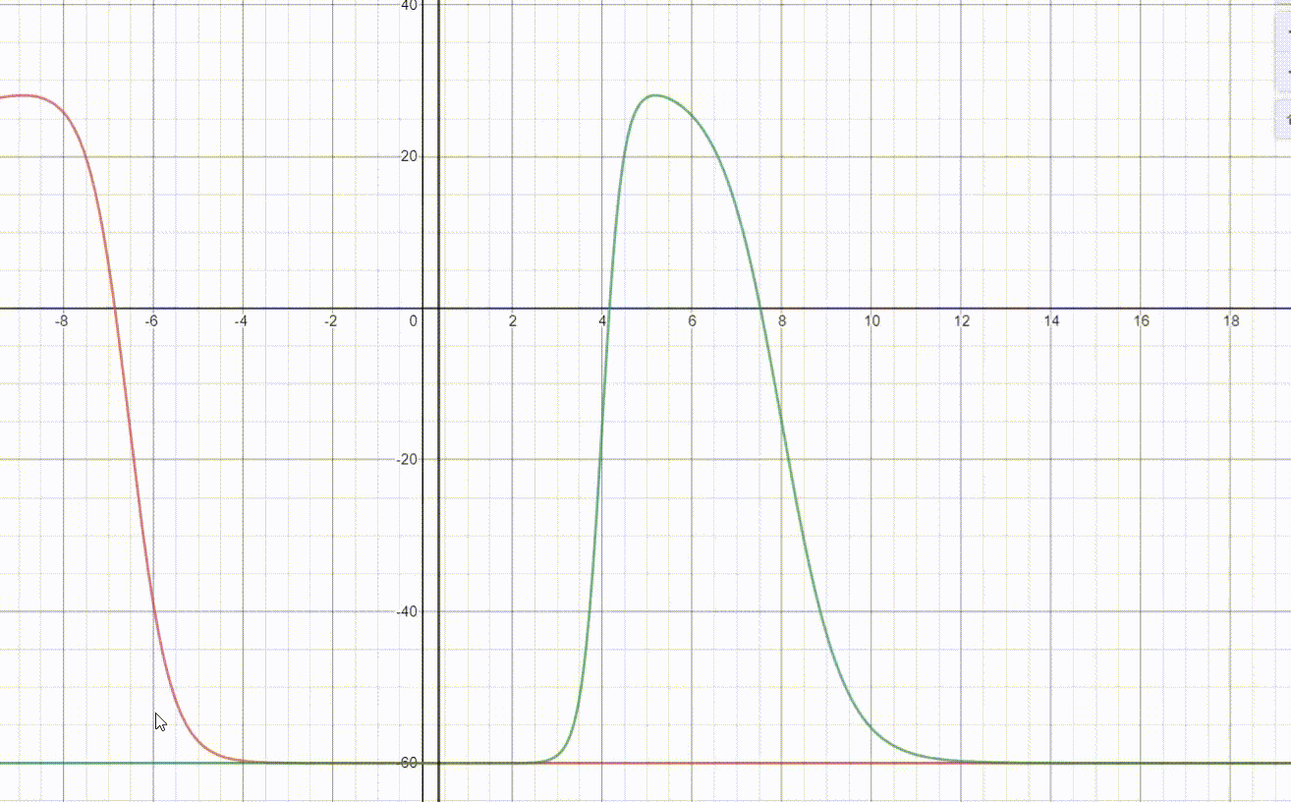
Transmembrane Voltage - Space/Time Relation
Notes:
we feel like this animation shows the relationship between the spatial and time graphs of an action potential very well
the black line represents the constant passage of time at a specific point
the red line represents the action potential moving across the membrane
the intersection of the black and red line give us the time profile of the transmembrane voltage at a specific point, and as a result, you can see the plot is flipped
hopefully this animation makes it more clear as to why the time profile of a right moving wave is flipped

Slide 8
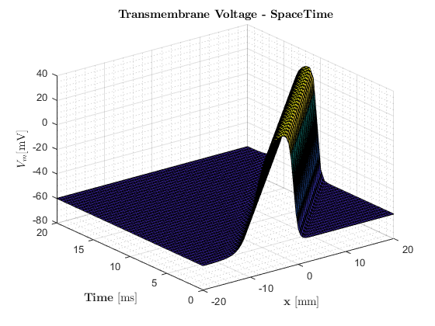
Transmembrane Voltage
Spatio-Temporal Profile
Equation:
Notes:
This is the temporal-spatial plot of the transmembrane voltage. As you can see, the time plot and the space plot are just a 2D snapshot of this 3D plot.
Now Luis will speak about the transmembrane current resulting from this action potential

Slide 9
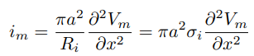
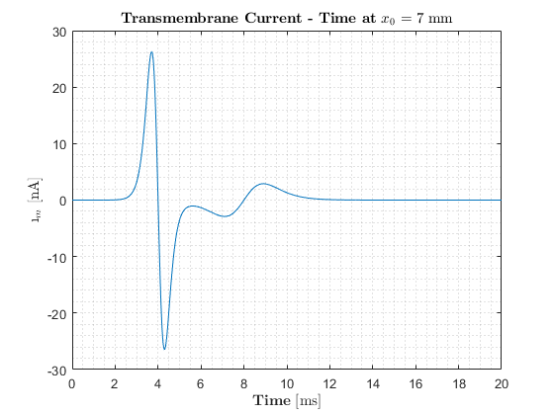
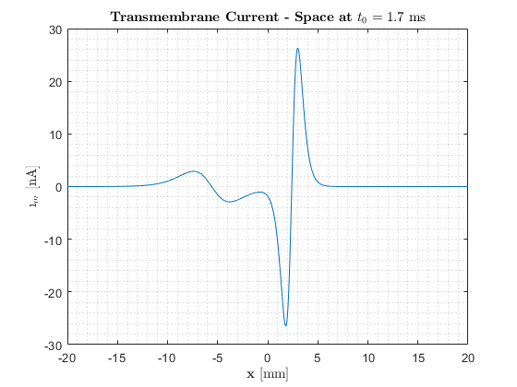
Transmembrane Current
Formula: Temporal Profile Space Profile
Notes:
Take a look at the equation of the transmembrane current at the top of the slide. It is proportional to the second derivative of the transmembrane voltage.
Now looking at its temporal profile, we see that the transmembrane current has 2 important large peaks that occur just before the action potential.
- The first corresponds to an increase in conductance of SODIUM as channels open up and SODIUM IONS rapidly rush into the cell.
- The second corresponds to the exit of POTASSIUM IONS as their ionic channels open up, slightly after the opening of sodium ions.
Now, we take a look at the space profile of the transmembrane current by looking at a single point in time. In this case, that is at 1.7ms
- We notice that compared to the temporal profile, the space profile is flipped, which is consistent with what we saw with the transmembrane voltage.

Slide 10
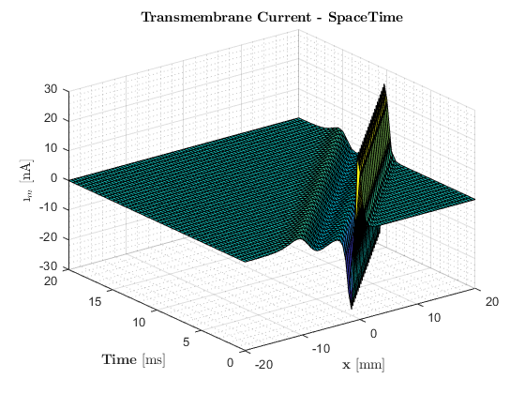
Transmembrane Current
Spatio-Temporal Profile
Equation:
Notes:
If we look at the space time behaviour of the transmembrane current we see how it propagates as a 3 Dimensional wave.
At the bottom of the slide we display the equation of the 3D wave, and we notice that it is much more complex than the initial voltage equation.
Therefore, to simplify the representation of the transmembrane current we resort to monopole representation.

Slide 11
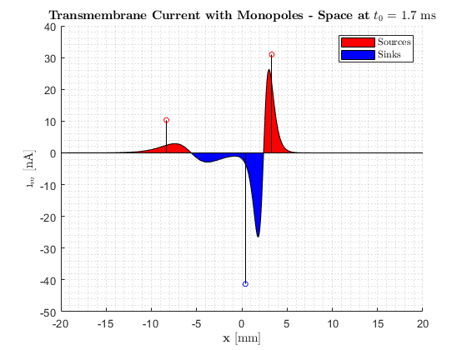
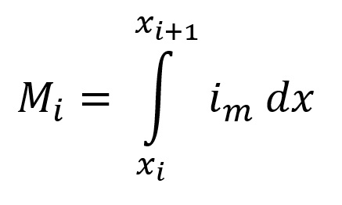
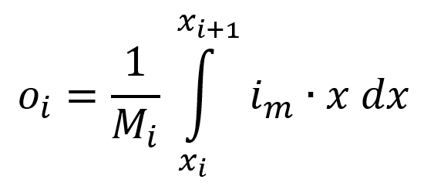
The Lumped Monopole Distribution, a Powerful Tool
Importance and Interpretation
Monopole Equation
Notes:
The process of representing the current as a set of sources and sinks is quite simple.
/* UPDATE THE GRAPH */
We take the area under the curve of the positive and negative sections of the graph and combine each into a single point, known as a monopole.
Then, we find the center of mass of each of the sections which gives us the appropriate location to place the each monopole.

Slide 12
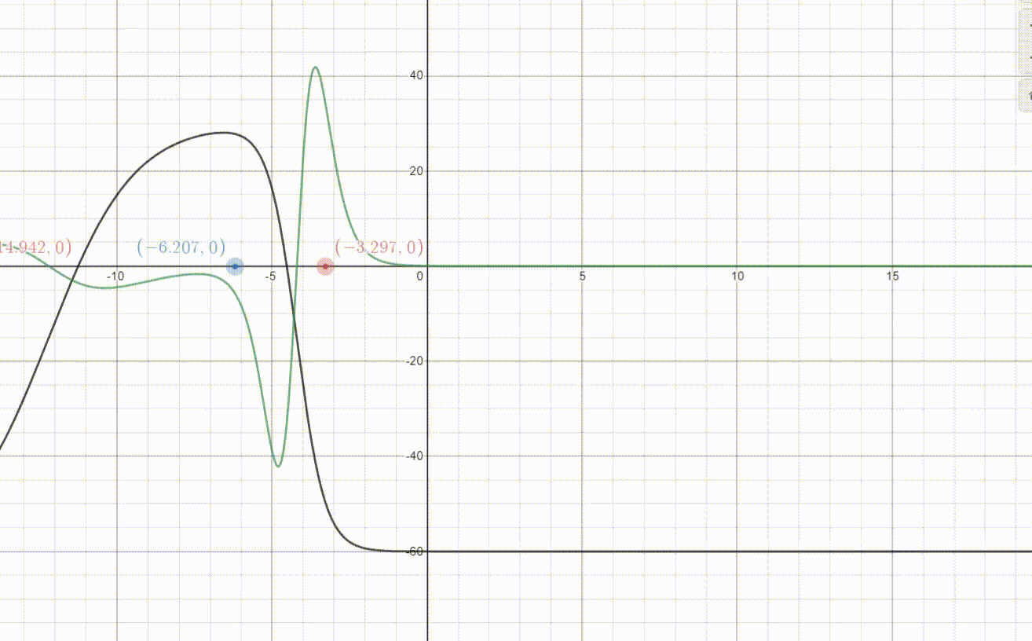
The Lumped Monopole Distribution, a Powerful Tool
Importance and Interpretation
Notes:
This animation shows the relationship between the transmembrane voltage in BLACK, the transmembrane current in green, and the resulting simplified current model as three monopoles moving at a constant speed.
Where the sources are in RED and the sink is BLUE.
This simplified model makes it a lot easier to computationally measure the effect of the action potential on the extracellular fields.
Which, Sebastian will now explain.

Slide 13
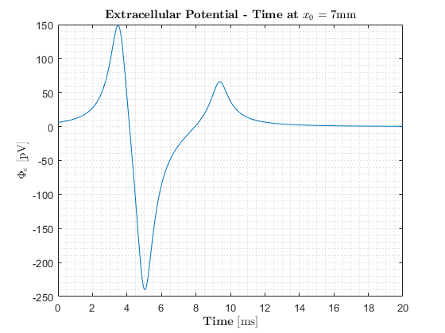
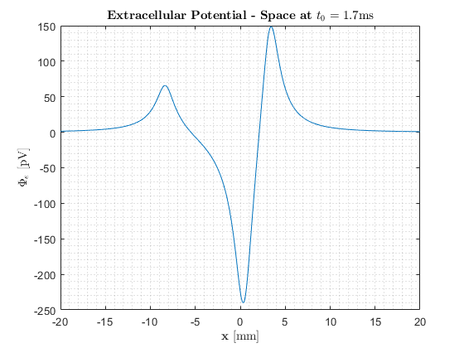
Extracellular Potentials, an Outside View
Temporal Profile Space Profile
Line parallel with membrane, 1 mm away
Notes:
Thank you Luis
once again most of the insight will come from the ‘space’ graph on the right (the time graph on the left is of the same shape but is flipped, just like with the transmembrane voltage and current)
for the extracellular potential, we need to choose a point to measure it from; we decided to use a line parallel with the axon wire, that is 1mm away from it
as you move across this line with time being constant, you can see that there are 3 distinct peaks, and they look to be in familiar places (next slide)

Slide 14
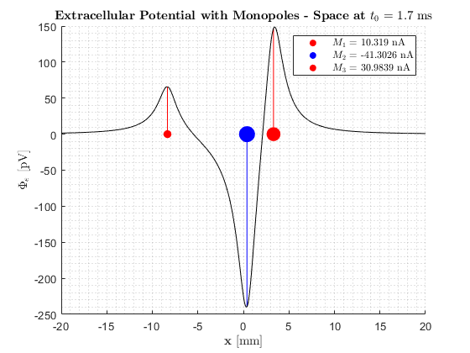
The Lumped Monopole Distribution, a Powerful Tool
Importance and Interpretation
Notes:
the peaks are pretty much in-line with the those of the monopole sources, which makes sense
the point in the line that is closest to the lumped monopoles will experience the highest magnitudes of potentials
if you have a keen eye you would also see that they are not completely aligned, which ALSO makes sense; since its a system of 3 points that are all interacting with eachother
for example you might be able to see that the negative peak potential near the sink is slightly to the left of the actual sink (next slide)

Slide 15
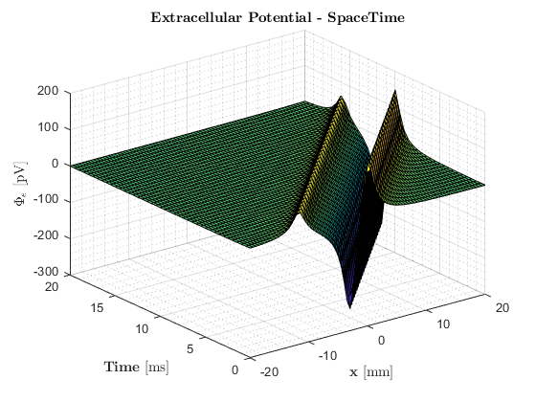
Extracellular Potentials, an Outside View
Spatio-Temporal Profile
Notes:
this graph looks similar to all the other 3d graph that we have seen, one difference is that is seems to be a little smoother
this is due to the fact that we are some distance away from the axon wire; because of this, the effect of the transmembrane current on the extracellular field gets smoothed out
so if we were even further away, the potential we would be experiencing would not only be smaller in magnitude, but would also have an even smoother curve
another factor is that the lumped monopole sources also have a very slight smoothing effect due to is approximating nature, but this is nearly negligible (next slide)

Slide 16
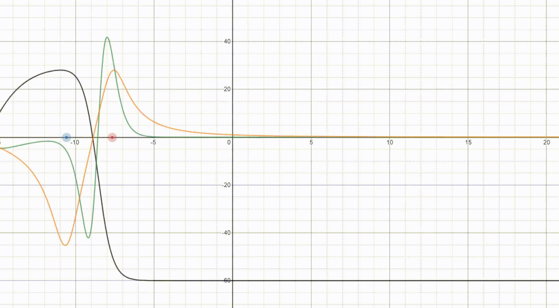
Extracellular Potentials, an Outside View
black - V_{m}
green - i_{m}
orange - Φ_{e}
red - sources
blue - sink
Notes:
here we have a very busy animation but we feel like it puts all our ideas together
in black we see the transmembrane voltage of our propagating action potential
in green we see the transmembrane current which is driving the changes in voltage
this transmembrane current is causing extracellular potential at the line that is parallel with our axon, this is seen in orange
finally we have the monopole sources in red and the sinks in blue
here you can more clearly see how the extracellular potential is smoother than the transmembrane current
we like this animation because we feel like it shows very well how all of the components will be propagating across the axon together
of course, in the real world there would be some slight variations, but as long as we have active propagation the amplitude of the AP will stay nearly the same
also if the radius of the axon is similar than the speed of propagation will also be approximately constant, and you would actually see an neat graph like the one we have here
Now Marcos will summarize our findings and give our closing thoughts

Slide 17
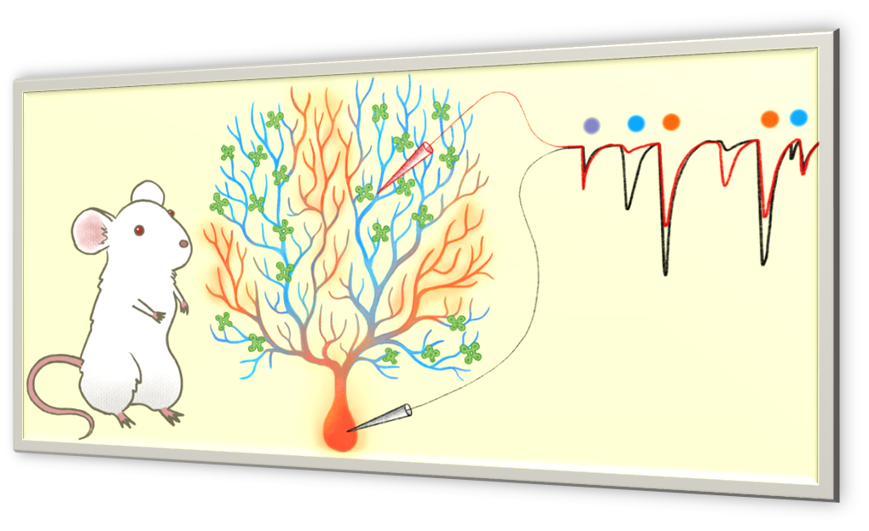



Summary
Many neurons have complex geometries and can be quite large (added difficulty; dendrites of cerebellar Purkinje cells, myriad of motor neurons).
For distal synaptic inputs a qualitative approach is difficult to formulate due to their size and complexity.
Notes:
Thanks, Sebastian.
Quickly summarizing the results of the project, we saw how a monophasic voltage signal traveled along a neural cable and how it reflected as a triphasic current. We then reduced this current function to a lumped monopole representation thus allowing us to evaluate the extracellular potentials at any point in space.
Thanks to this project we can see firsthand how the cable theory’s quantitative approach to neuron modeling neatly arranges for the complexity of neurons in both geometry and size (an example of the former being the forests of dendrites of cerebellar Purkinje cells, and of the latter the myriad of motor neurons that span the body) giving a remarkable view of the propagation of an action potential.
This simplification is quite powerful indeed, for it has the capacity to model complex dendritic trees with multiple inputs with highly nonlinear behavior.
Due to this selfsame opportunities and difficulties in neuron modeling, qualitative approaches often fall short in describing the propagation of action potentials as well as this quantitative model does. Alas it is worth noting that research is being done regarding this and methods such as the 2-photon microscopy approach are being developed to study this field qualitatively.

Slide 18
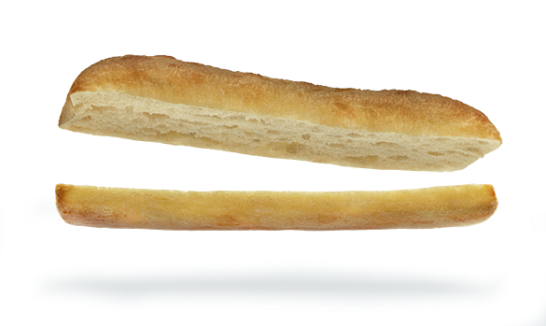


Closing Thoughts
Cable theory assumes that neurons only interact significantly at specific locations.
Spikes in one neuron could cause a depolarization of several mV in a dendrite or axon passing by its initial segment.
Such interactions could play a role in controlling action potential failure at branch points [1].
We still need better qualitative methods for evaluating transmission of action potentials.
Notes:
Cable theory assumes that neurons only interact significantly at anatomically specific locations (such as axonic boutons and gap junctions).Nevertheless research such as the one conducted by Gary Holt in his thesis called A critical reexamination of some assumptions and implications of cable theory in neurobiology, suggests that pikes in one neuron could cause a depolarization of several mV in a dendrite or axon passing by its initial segment and that such interactions could play a role in controlling action potential failure at branch points
Going into the future the opportunity exists in research of better qualitative methods for evaluating transmission of action potentials. As well as reevaluation of the assumptions behind cable theory.

Slide 19
References
Holt, Gary R. (1998) A critical reexamination of some assumptions and implications of cable theory in neurobiology. Dissertation (Ph.D.), California Institute of Technology. doi:10.7907/HPPC-S237. https://resolver.caltech.edu/CaltechETD:etd-09122006-135415
Hodgkin, A. L., Huxley, A. F. and Katz, B. 1952. Measurement of current-voltage relations in the membrane of the giant axon of Loligo. J. Physiol. 1952. 116: 424.
Hodgkin, A. L. and Huxley, A. F. 1952a. Currents carried by sodium and potassium ions through the membrane of the giant axon of Loligo. J. Physiol. 116: 449.
Scott, A.C., 1975. The electrophysics of a nerve fiber. Reviews of Modern Physics 47: 487.

